Slide 1
ECG Diagnosis and using Electro Cardio Graphy
A.L. Maher Abdul Ameer Atiyah

Slide 2
DEFINITION ECG(electrocardiograph)
• ECG is define as " recording of electrical activity of heart on a graph paper.
" Or
• Graphical representation of electrical activity of heart.

Slide 3
Overview of procedure
GRIP
Greet, rapport, introduce, identify, privacy, explain procedure, permission
Lay patient down
Expose chest, wrists, ankles
Clean electrode sites
May need to shave
Apply electrodes
Attach wires correctly
Turn on machine
Calibrate to 10mm/mV
Rate at 25mm/s
Record and print
Label the tracing
Name, DoB, hospital number, date and time, reason for recording
Disconnect if adequate and remove electrodes

Slide 4
Significance of ECG
• ECG gives information about rate and rhythm of the heart.
• The physical orientation of heart i.e. axis,
• Its a diagnostic tool for various heart conditions like hypertrophies, ischemia, infarction , arrhythmias conduction problems and pace maker activity.
• ECG does not provide information about mechanical activity.

Slide 5
Electrophysiology
- Pacemaker = Sinoatrial node
- Impulse travels across atria
- Reaches AV node
- Transmitted along interventricular septum in Bundle of His
- Bundle splits in two (right and left branches)
- Purkinje fibers

Slide 6
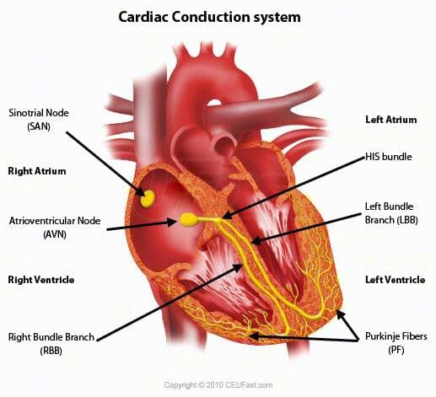

Slide 7
ECG Paper
• This is long role of paper ,composed of small squares.
• One square is 1mm wide and 1 mm high.
• On ECG paper there are thick lines, between two thick lines (large square) there are 5 small squares.
• The speed of ECG machine is 25 mm per second.

Slide 8
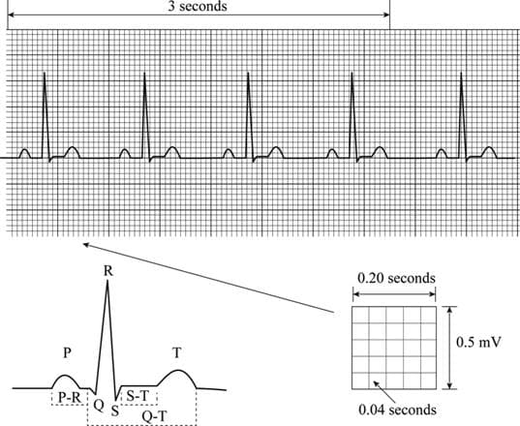

Slide 9
ECG Paper
• The time internal of each small square can be calculated as
25 small sqrs are equal to 1 second.
1 small sqr is equal to 1/25 second
i.e 0.04 seconds.

Slide 10
ECG Paper
• vertically the small square represent the amount of electrical potential.
• One small sqr represent the potential of 0.1 mv.
• 10 small squares represent the potential of 1 mv.

Slide 11
ECG Leads
• leads are electrodes which record the electrical potential of heart at different sites.
• There are 12 ECG leads :
a) 3 bipolar limb leads.
b) 3 augmented limb leads.(unipolar).
c) 6 chest leads.

Slide 13
Leads and what they tell you
Limb leads
Limb leads look at the heart in the coronal plane
aVL, I and II = lateral
II, III and aVF = inferior
aVR = right side of the heart

Slide 14
Leads and what they tell you
Each lead can be thought of as ‘looking at’ an area of myocardium
Chest leads
V1 to V6 ‘look’ at the heart on the transverse plain
V1 and V2 look at the anterior of the heart and R ventricle
V3 and V4 = anterior and septal
V5 and V6 = lateral and left ventricle

Slide 15
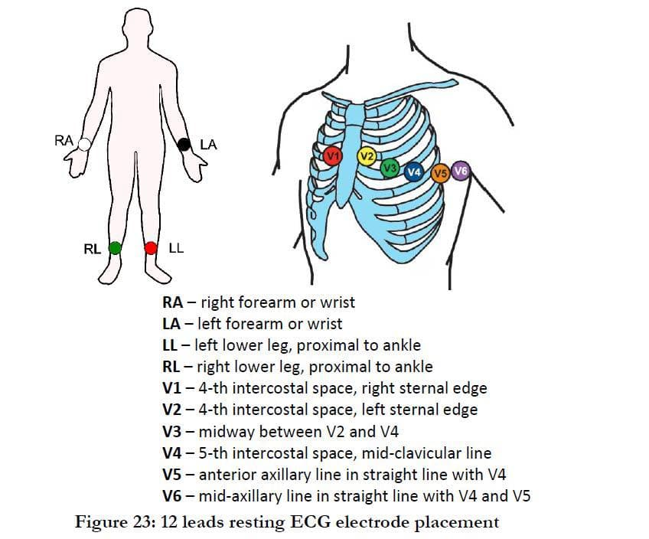

Slide 16
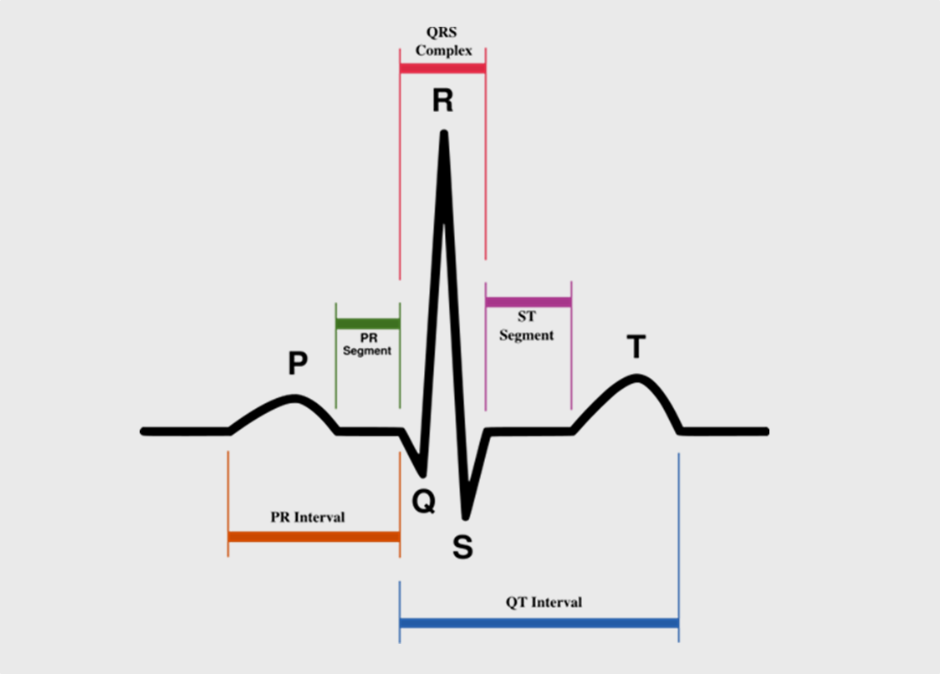

Slide 17
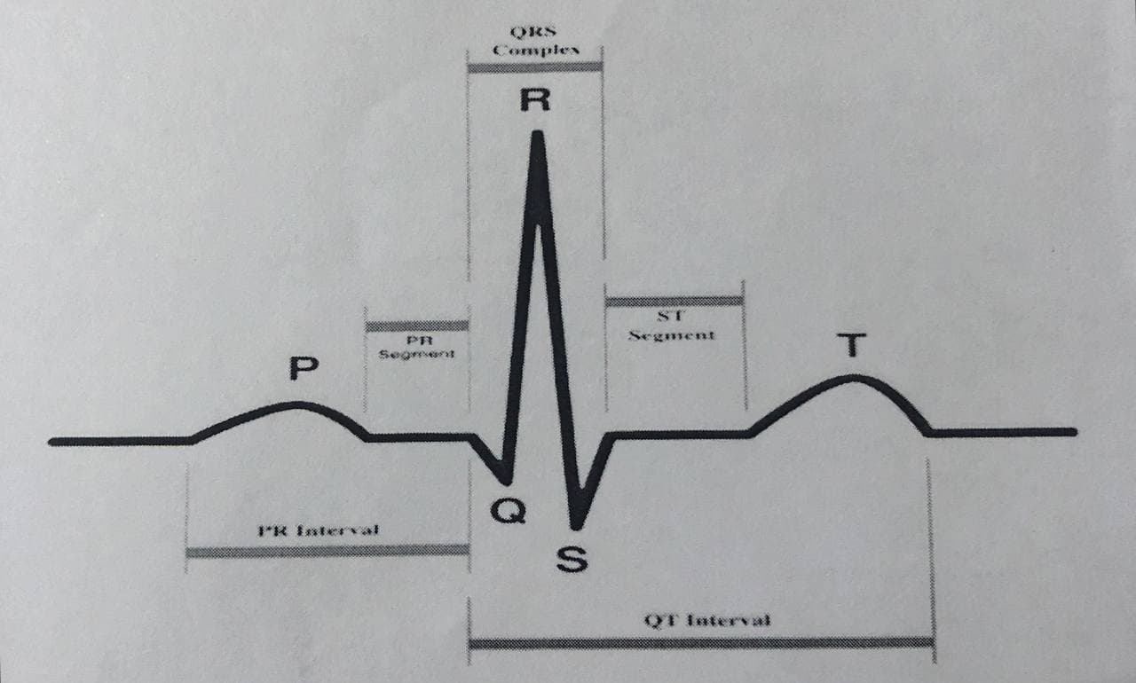
What do the components represent?
PQRST = One EKG complex = One Cardiac Cycle
Total Duration of a Cardiac Cycle = 0.8 seconds (20 small squares)

Slide 18
Wave Forms
P wave = atrial depolarization
QRS = ventricular depolarization
T wave = ventricular repolarization
Interpreting the ECG :
1. Calibration
2. Rhythm
3. Rate

Slide 19
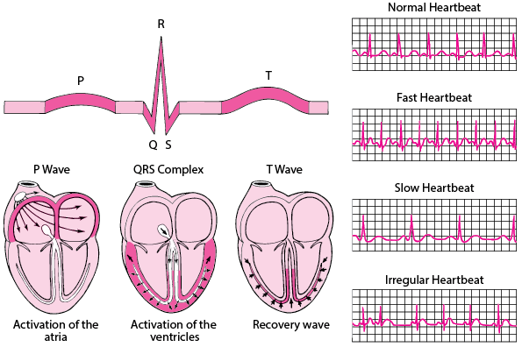

Slide 20
1- calibration
Check that your ECG is calibrated
Height:
- It should be 10mm (10 small squares ) tall.
Paper speed :
-25mm/s
-25 mm (25 small squares / 5 large squares) equals one second

Slide 21
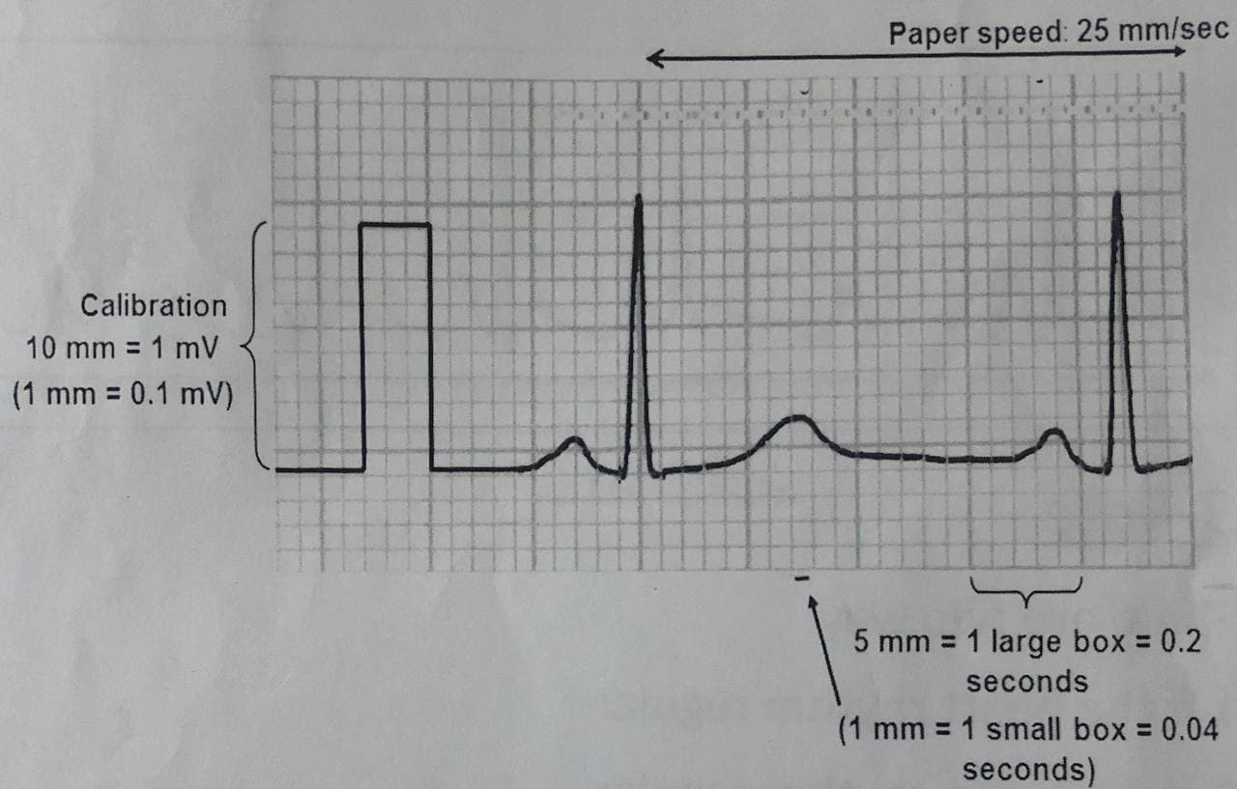

Slide 22
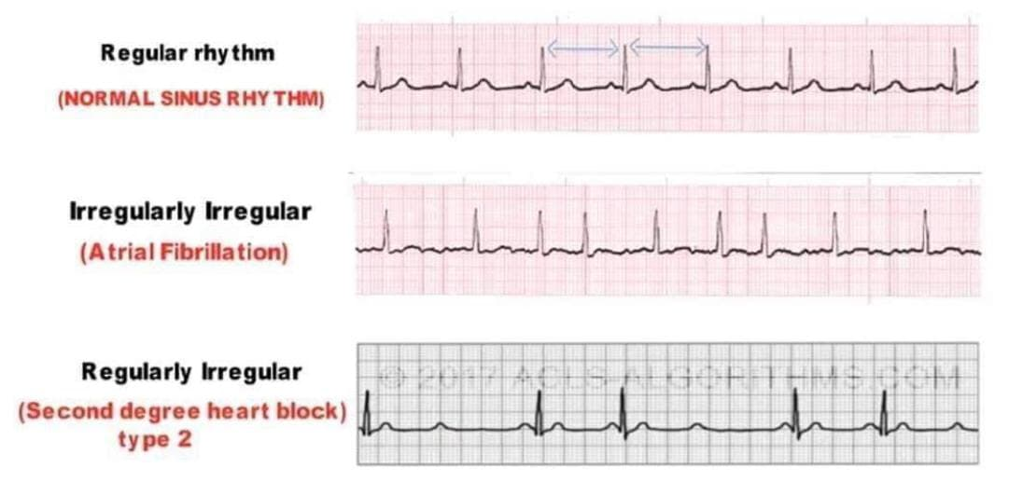
2- Rhythm

Slide 23
3-Rate
There are two way:
1-If the heart rhythm regular
300
HR= ________________________________
Nub. Large sqr. Between R and R
2-If the heart rhythm irregular
- Number of R inside 30 large squares and multiply the number R by 10

Slide 26
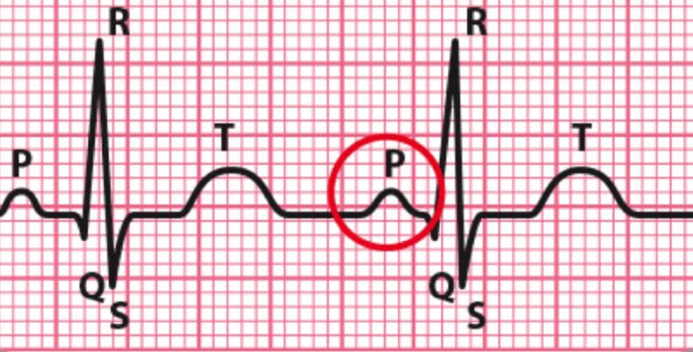
P wave
• P wave shows atrial depolarization..
- Height
P wave Height less than 0.08s(2 small squares)
- Length
P wave Length less than 0.12s(3 small squares)
• Presence of P waves in ECG strip shows the sinus rhythm.

Slide 27
Height
-A tall P wave (over 2 small squares) can be called P pulmonale
-Occurs due to R atrial hypertrophy
-Causes include:
- pulmonary hypertension
- pulmonary stenosis
- tricuspid stenosis
Length
P wave with a length >0.12 seconds (3 small squares) and a bifid shape is called P mitrale
- It is caused by left atrial hypertrophy.
Causes include:
1-Mitral valve disease
2-LVH

Slide 28
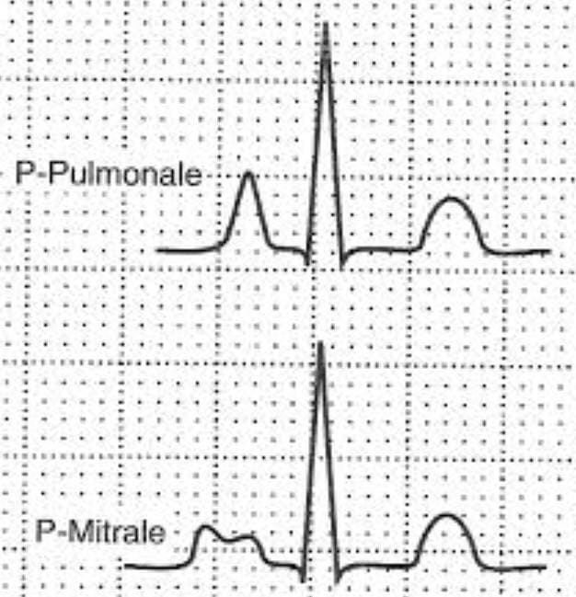

Slide 29
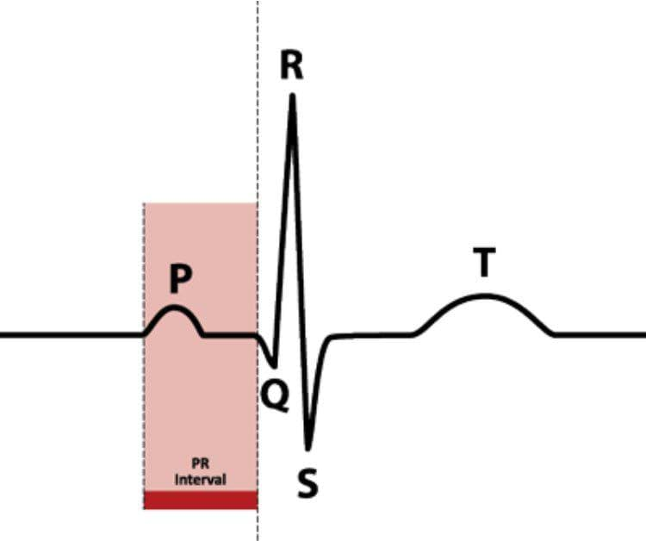
PR-interval
-the PR interval is measured between the start of the P wave to the start of the QRS start.
-A normal PR interval is between 0.12 to 0.20 seconds ( 3 -5 small squares).

Slide 30
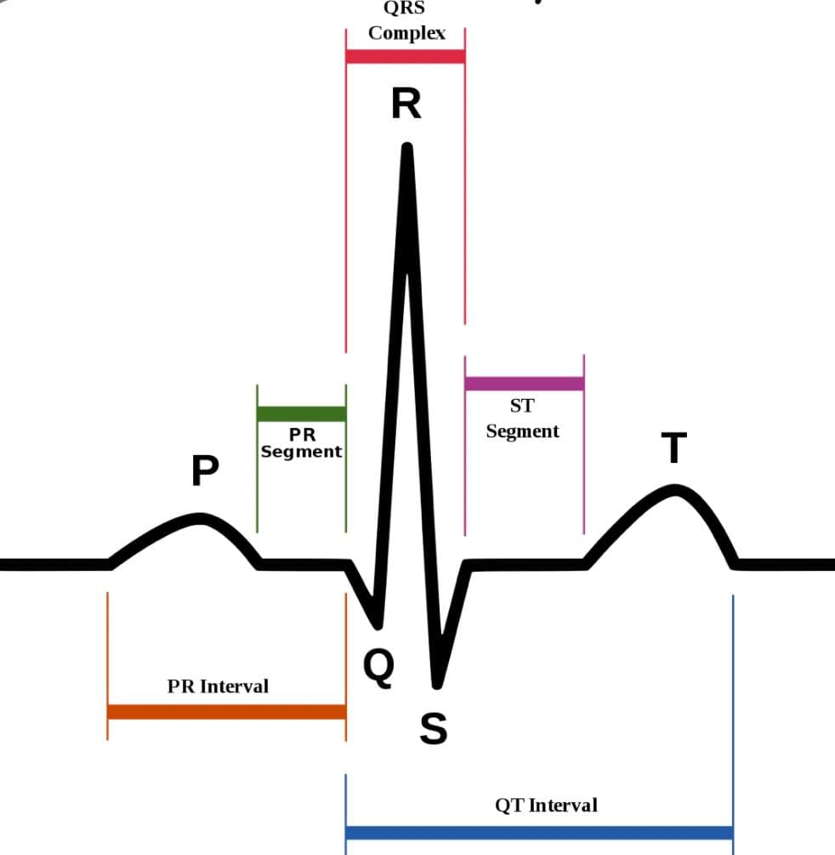
QRS complex
The width of the QRS complex should be less than
0.12 seconds (3 small squares)

Slide 31
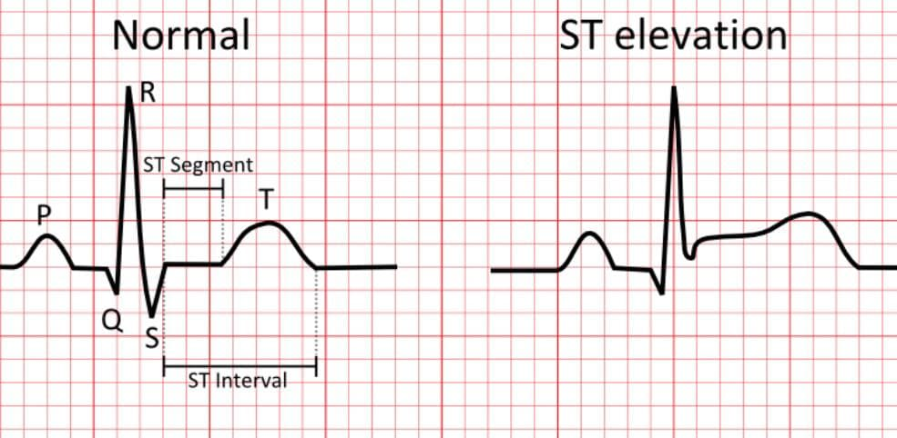
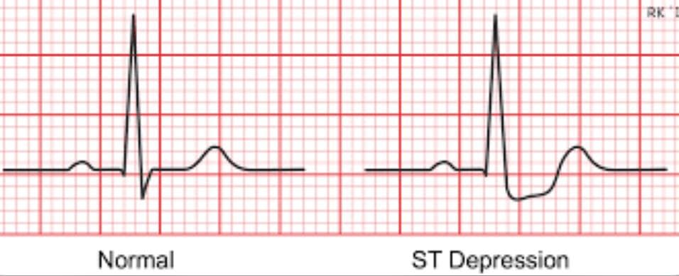
The ST segment
Normal ST segment should sit on the isoelectric line
Planar ST elevation can represent an MI
Planar ST depression can represent ischemia

Slide 32
- causes of elevation include acute MI (e.g. anterior, inferior), left bundle branch block, normal variants (e.g. athletic heart, Edeiken pattern, high-take off), acute pericarditis
- causes of depression include myocardial ischemia, digoxin effect, ventricular hypertrophy, acute posterior MI, pulmonary embolus, left bundle branch block

Slide 33
T wave
- No definite rule for height T wave
- generally shouldn't be taller than half the size of the preceding QRS
-If the T wave is more taller than half the size of preceding
QRS it may indicate Hyperkalemia
-If the T wave is flat, it may indicate Hypokalemia
-If the T wave is inverted it may indicate ischemia

